Slide 1


Gaming Sentiment Analytics Use Cases

Slide 2
Use Cases for User Experience

Slide 3






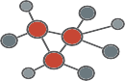
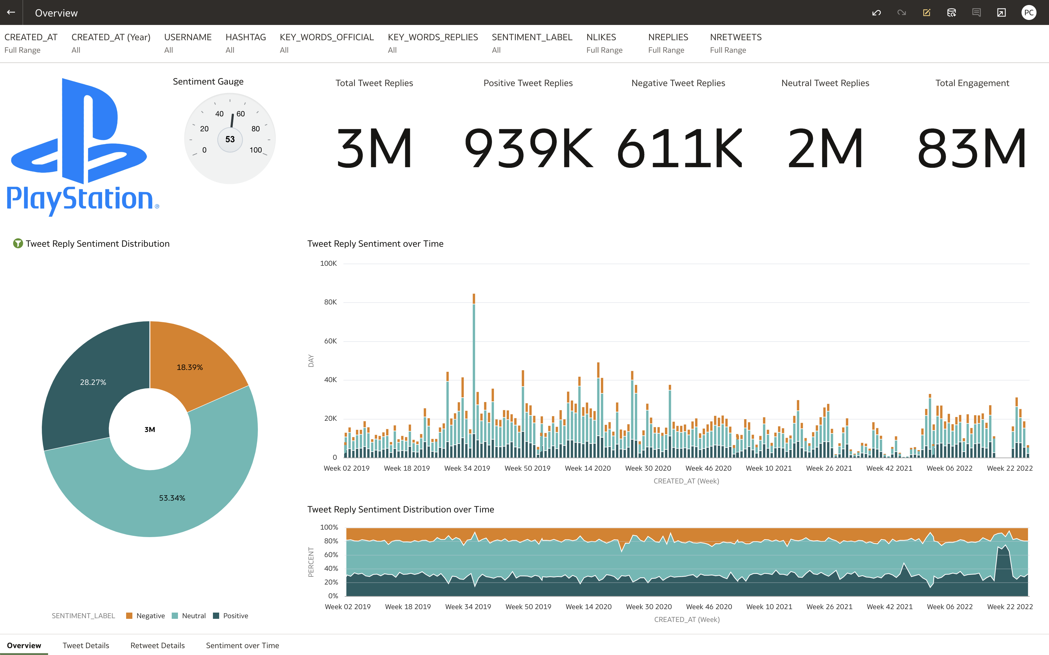













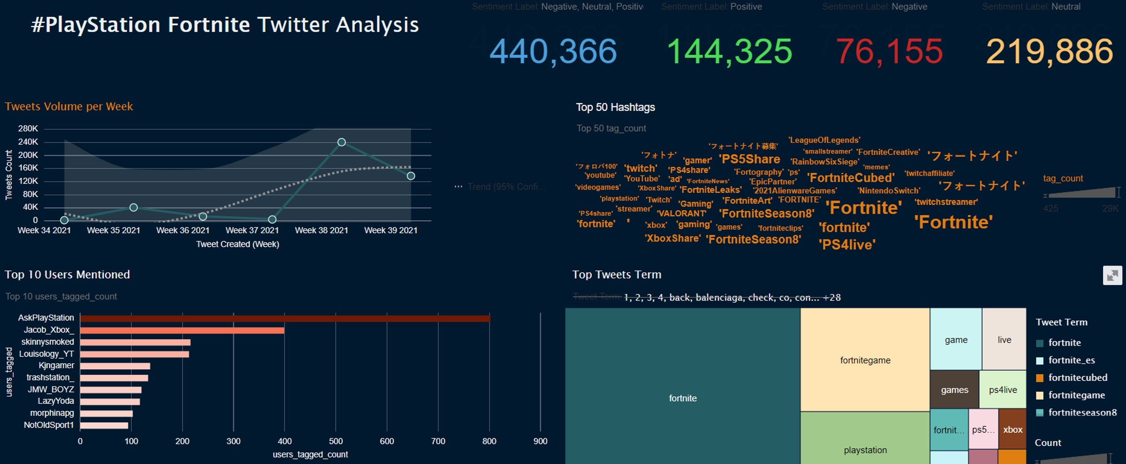









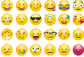

Use Case: Gaming Sentiment Analysis
Analysis for Fortnite 8
Graph Analytics
Spatial
Analytics
PGX
API/ Batch Downloader
Data Science Service
NLP
Autonomous Database
Autonomous Database
Object Storage
3

Slide 4


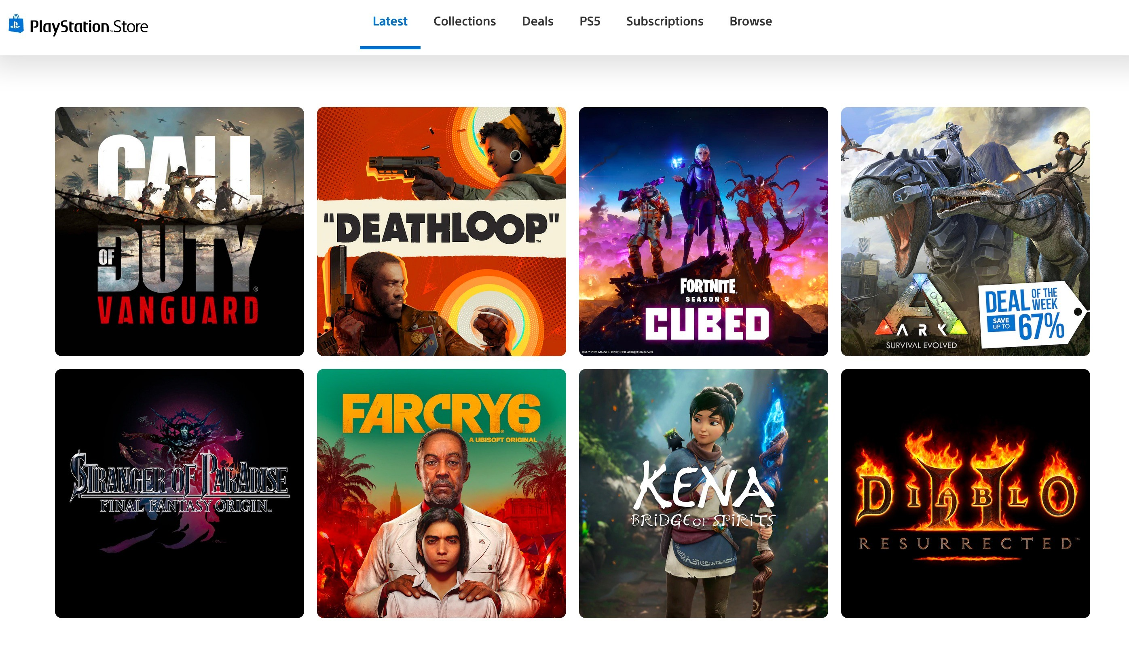
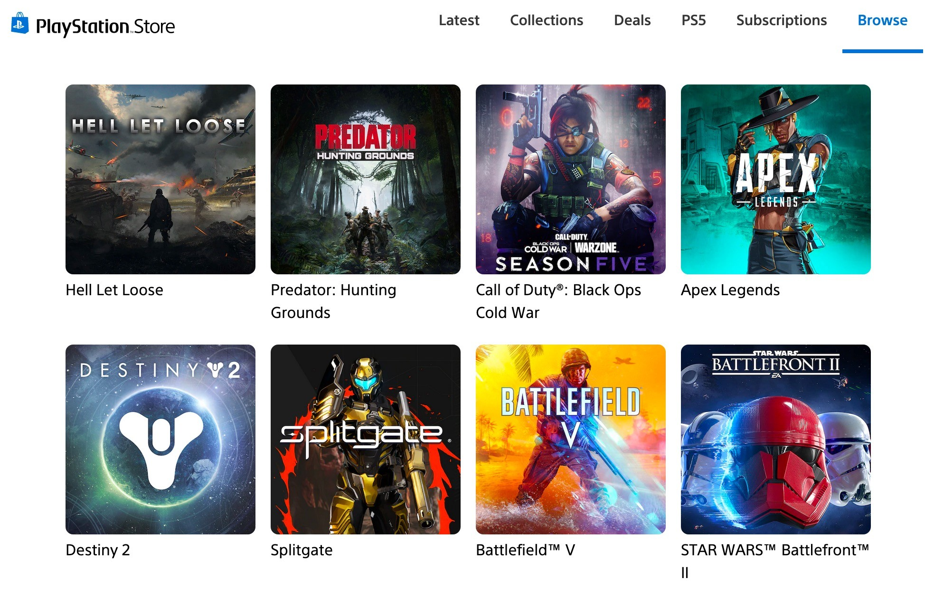




Use Case: Content Personalization
VideoGame Content Personalization
Users Journey
Data Collection
Messaging & Content personalization
Predictive Data feed
ML Predictive
Runtime Service+
4

Slide 5








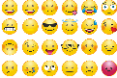

Use Case: Development Service Workflow
Notify Tickets to Video Game Development Team
Data Sources
Data Science Service
NLP
Autonomous Database
Support Ticket Generation
CI/CD Pipeline 1
Bug Collection
Autonomous Database
Serverless
Notifications
Social Media Damage Control
CI/CD Pipeline 2
Ops Engineer
5

Slide 6


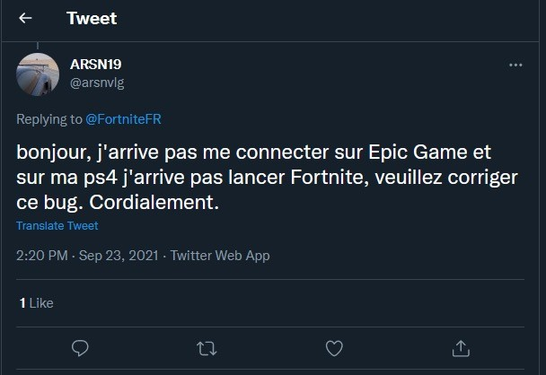
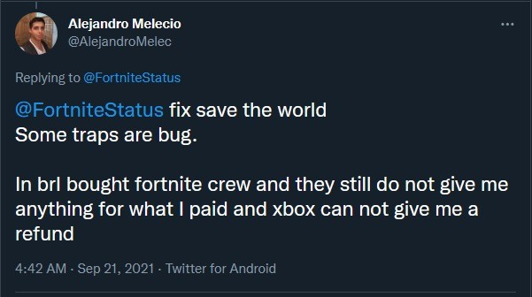
Understanding the issue
Use Case: Comparing Device Behavior
XBOX vs PS4
Sentiment Analysis in PS4
Sentiment Analysis in XBOX

Slide 7

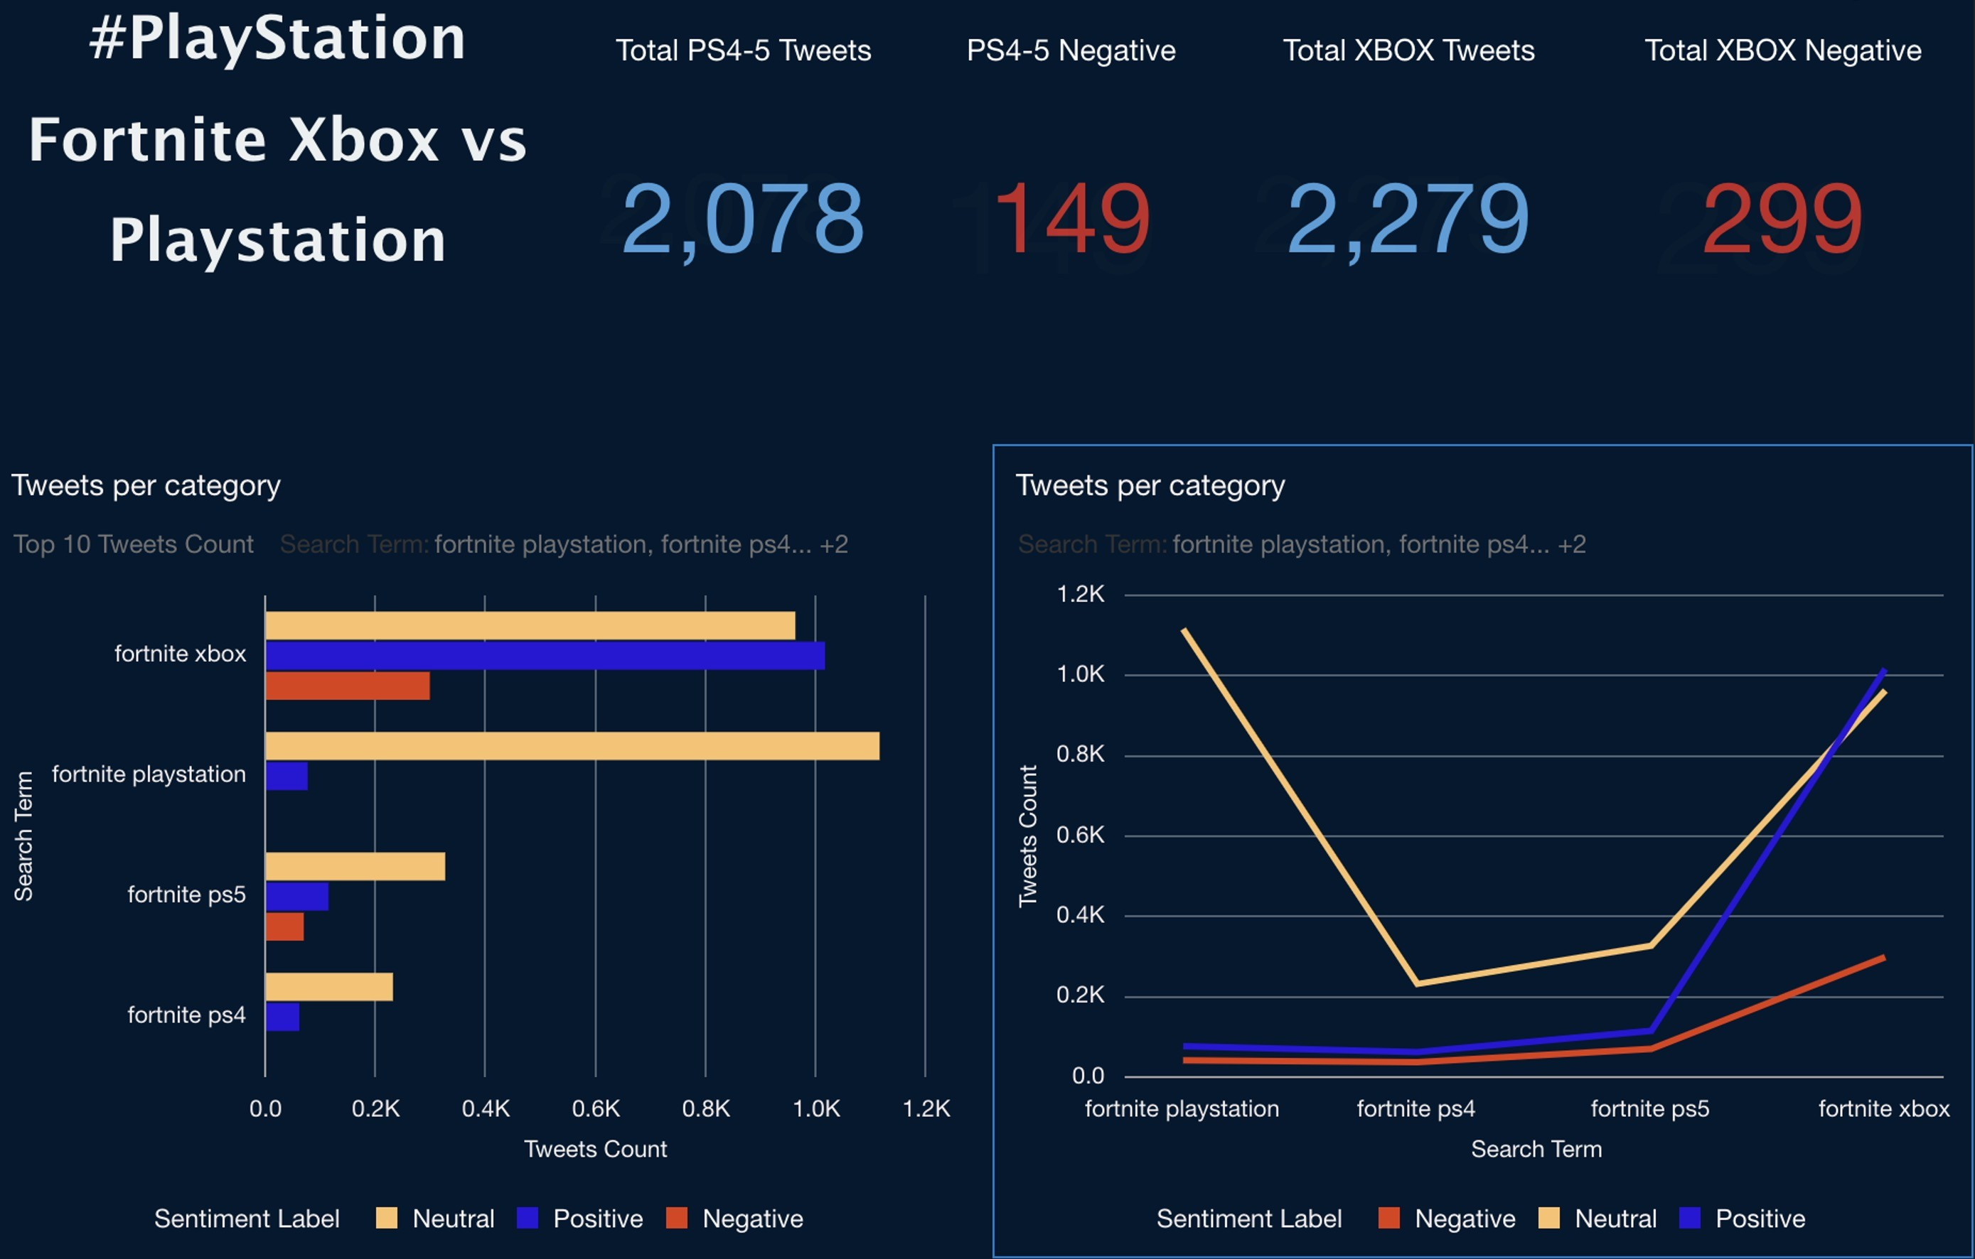
Dashboard: PlayStation vs. XBOX

Slide 8
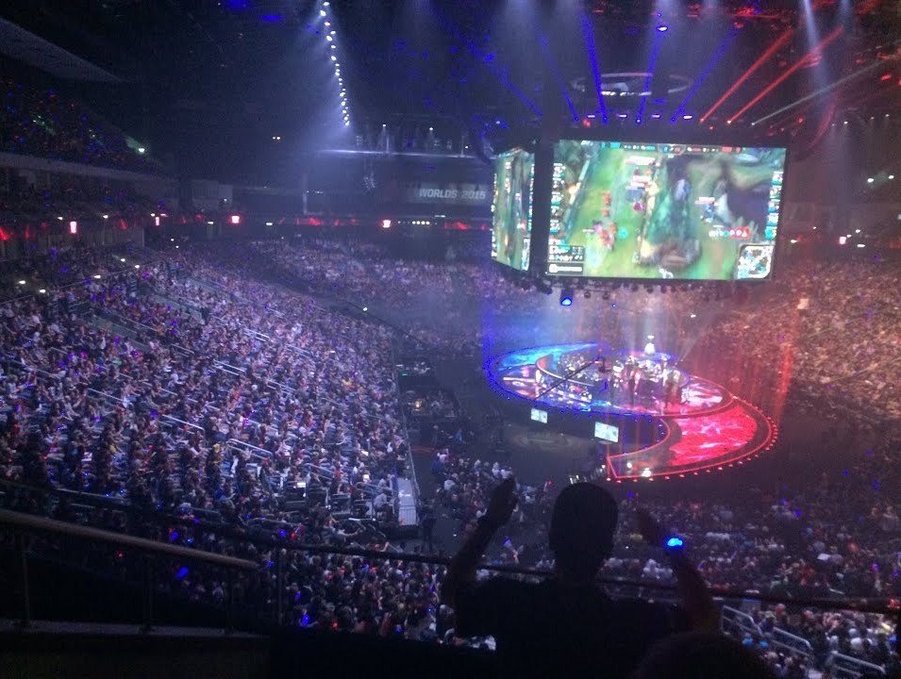
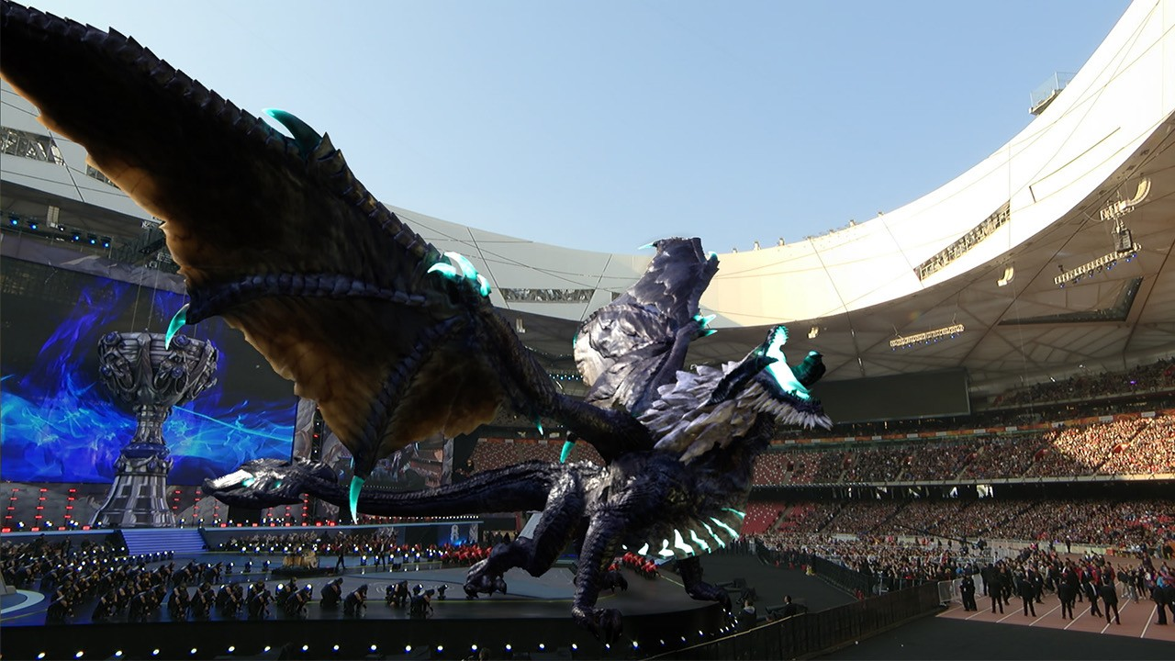
Use Case: Perform Outcomes using Prediction
ML Use
Using ML to Predict Outcomes
League of Legends
8

Slide 9
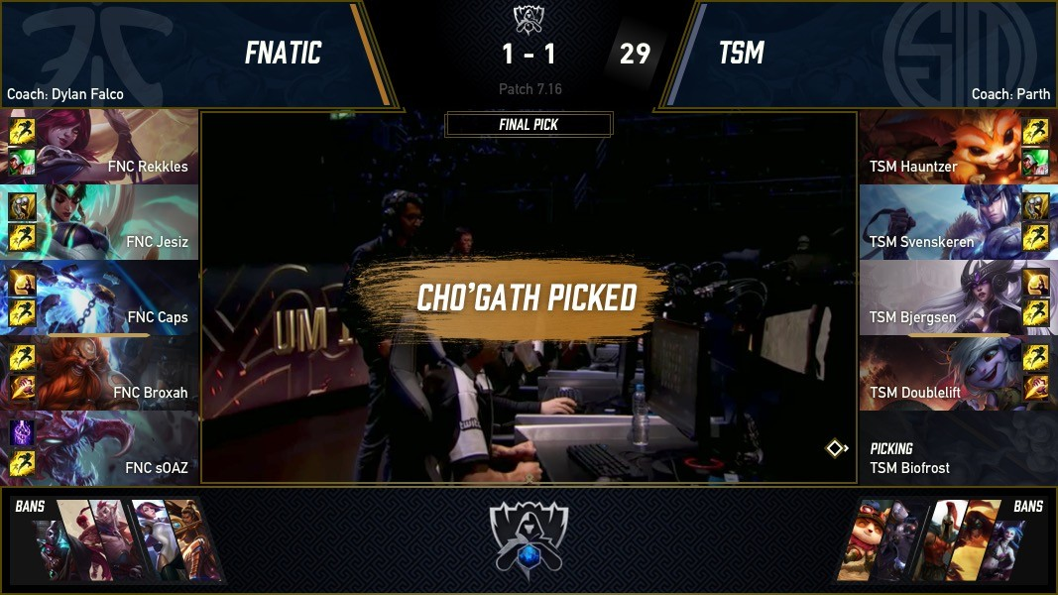
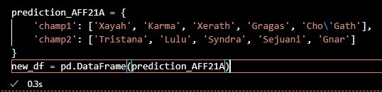
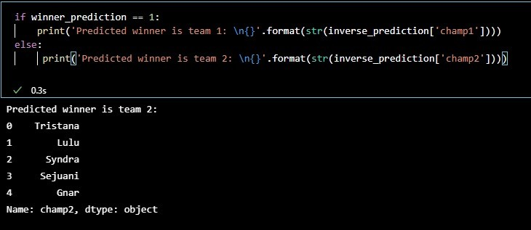
Using ML to Predict Outcomes
Use Case: Perform Outcomes using new Scenarios
Dynamic configuration of Video Games
Apply same approach for Game Catalog
9

Slide 10


